Slide 1
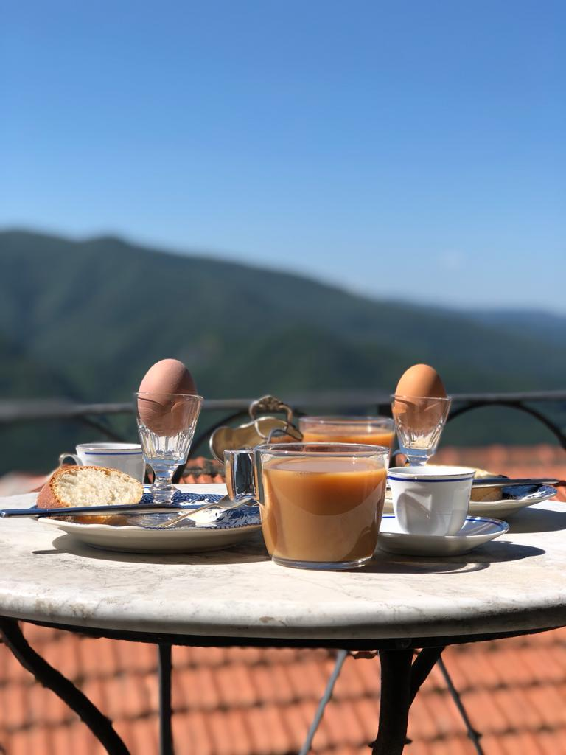
Welcome to Casa di Mister John…
This beautiful medieval accommodation was lovingly restored by my uncle, John Riley. It was a wreck when he bought it, but through sheer hard work, and his amazing attention to detail, 20 years on, it is complete, and we are sure you will agree, it is beautiful.
A few notes for your stay… Electricity is certainly available, but a little limited… running a hairdryer, the kettle or dishwasher is absolutely fine, just not at the same time! Should there be a short circuit, you will find the circuit board behind the grandfather clock in the Ingresso. (Entrance) Just carefully slide the clock toward you.
The power points next to the bed in the Orange Room are found in the bedframe! (We told you John had a fine eye for detail!) There are two either side. You are best to use the points furthest away from the side tables. The ones closest to the bedside tables are where the lighting is plugged in. You can turn on the bedside lights using the toggle in the centre of the bed head. You will find another power point in the wardrobe. Should you want to open the flyscreens in the bedrooms, please be careful doing so.
Enjoy a nice hot shower but be aware that as it is only a small water tank, the hot water is a little limited. Please be careful when using the shower hose not to let it drop down onto the tiles. Turning the tap off to quickly will sometimes cause the shower hose to drop down, hence the wire securing it in place. And please, only toilet paper and human waste down the toilet.
The washing machine, located in the Ingresso, can be turned on at the power point to the rear, left hand side of the machine. Here you will also find an iron/ironing board, and a picnic bag! Please use the recycling bags situated in the urn in kitchen. There is a blue bag for paper and a yellow bag for plastic. Pop your bottles in here also. The general rubbish bin is located underneath the fridge. Jess will sort this after your stay

Slide 2
The internet is….
TIM 5kCn3s
PASSWORD: 7U76472N5Q
You will find a TV neatly hidden within the bookcase. Please feel free to use the Apple TV to watch Netflix etc. To work the TV/Apple TV…
Open the bottom cupboard door to the left. Here you will find the Apple TV.
Using the larger black remote control, select Power On (make sure TV button is lit) > Input > HDMI
Using the smaller remote, turn Apple TV on. Below the large scroll dial at the top, to the right, is the Home Screen. If you want a different app, press the Home button twice. Use the scroll button to find various apps. Sign in, but don’t forget to sign out!
Please feel free to use Alexa also!
Should you find the nights chilly, you will find a wood burning stove and firewood. In the Cantina (basement) you will find extra firewood. You will also find electric blankets, heavier duvets, and blankets in the bedroom wardrobes.
A small favour to ask… Could you please be so kind as to water the vine on the balcony whilst you are there?

Slide 3
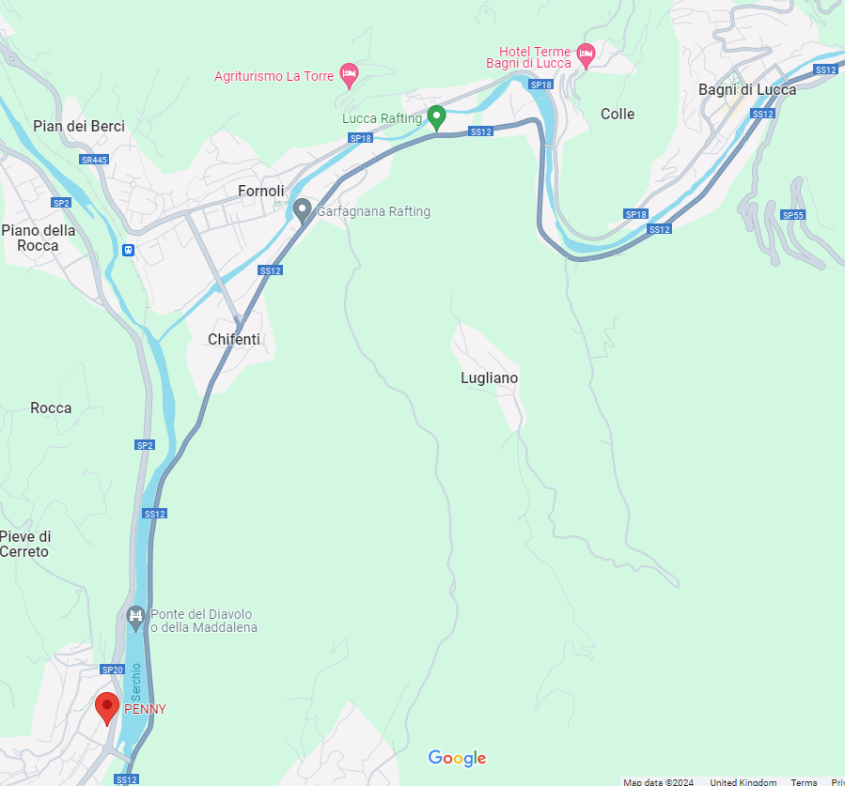
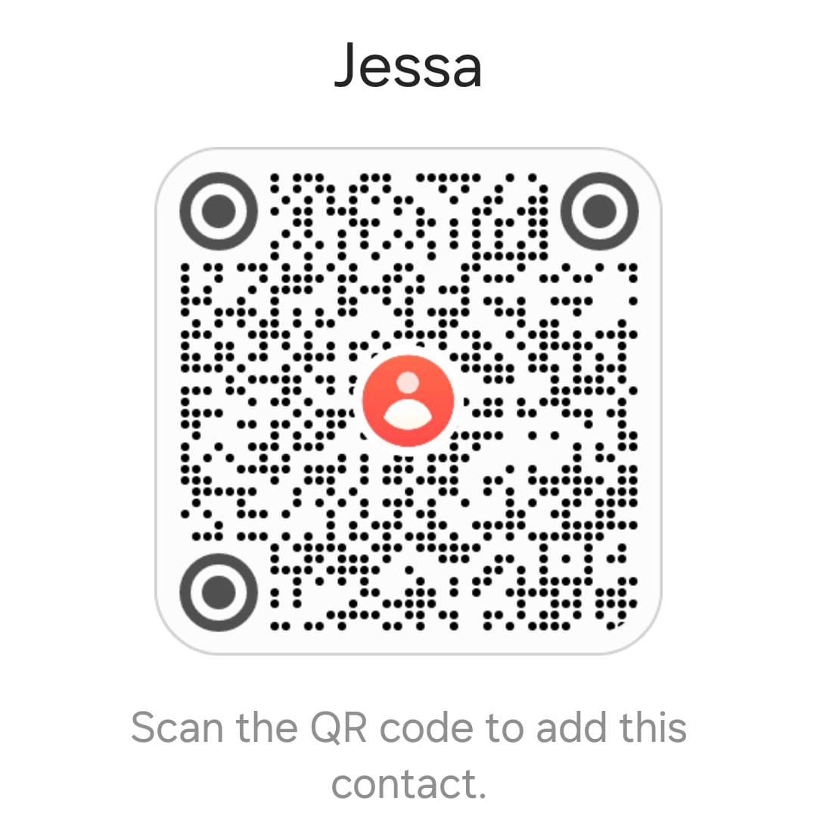
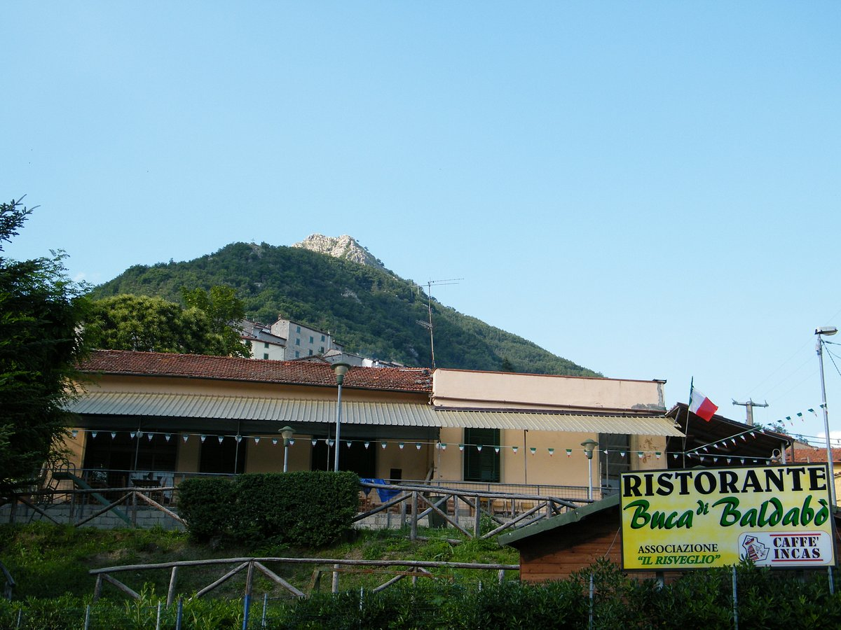
OUT AND ABOUT…
Groceries
You will find ridiculously inexpensive wine at Penny Market, Via Ludovica, 4, 55023 Borgo a Mozzano. https://maps.app.goo.gl/HXd3JSHheAsXF87g7
(closes at 8pm)
The nearest village to Vico is Bagni di Lucca. There you will find plenty of shops, bars, and cafes.
On Tuesday mornings at 10/11 am, you will find the bread cart outside of the Buca, and on Friday afternoons, between 3 and 4pm the fruit and veg van is at the same place. Always fresh and delicious. You can also contact Jessa, who sells beautiful, organic fruit,veg and eggs also. +39 350 1142578
Restaurants and cafes in Vico
Check out the wonderful, award winning Buca Di Balbabo. (Known as the Buca to the locals) The food is marvellous and not to be missed. They also do take away pizza on a Sunday, but these must be booked in advance…phone 0583 800171 www.labucadibaldabo.it

Slide 4
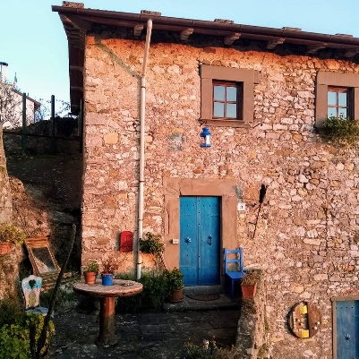

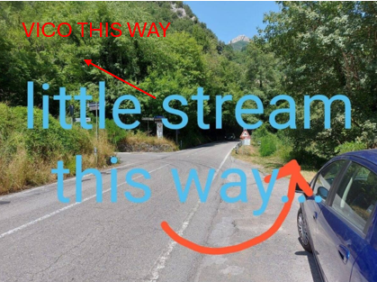
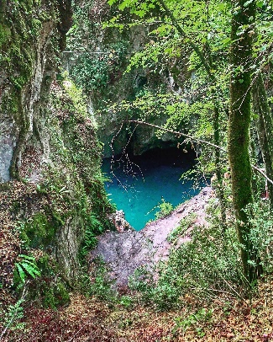
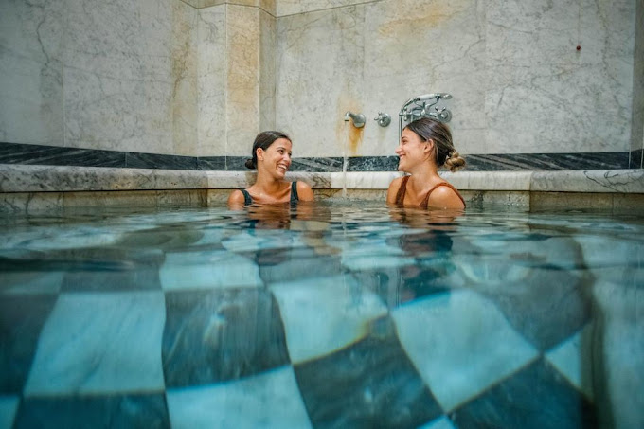
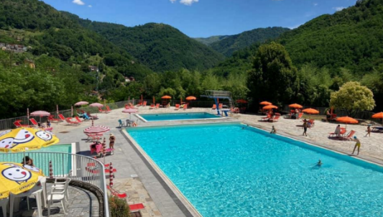
A must-do dining experience is just a stone's throw from Casa di Mister John's.
The Casa Dalle Porte Blu. Here, your lovely host, Monica, will serve you the most beautiful food, created and prepared with love herself.
Please book in advance through me so she can gather her delicious ingredients!
Monica also sells beautiful vintage clothes and Bric à Brac. Don't leave without taking a tour!
Chill time…
At the very bottom of the road, near the corner of the main road, you will find a nice stream if you feel like taking a swim.
Thermal Spa, Bagni di Lucca
https://termebagnobernabo.it/
The swimming pool at Bagni di Lucca is beautiful, but please check the opening hours. https://maps.app.goo.gl/sBmWajGmM4YWSMNd7
Canyon Park is a must do experience for those who are thrill seekers, or if you fancy a bit of yoga and wellbeing! Check them out here…
https://www.canyonpark.it/

Slide 5
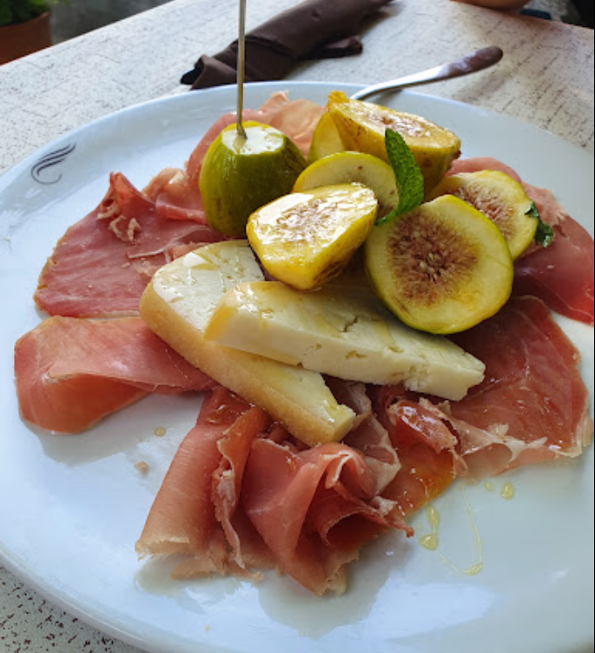
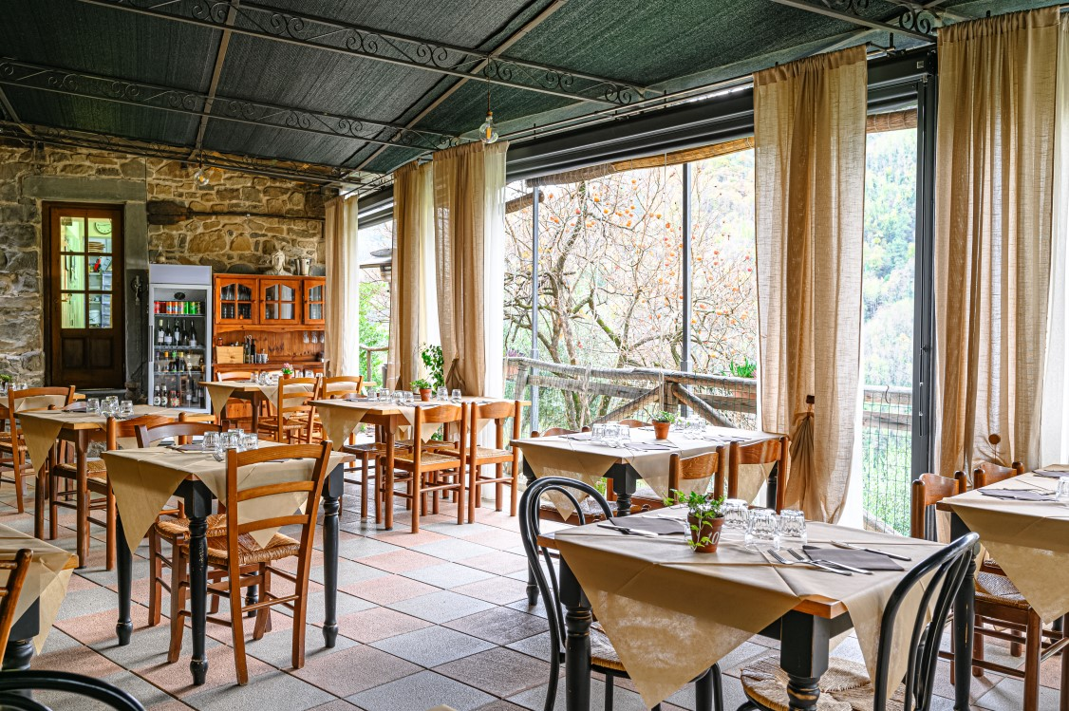
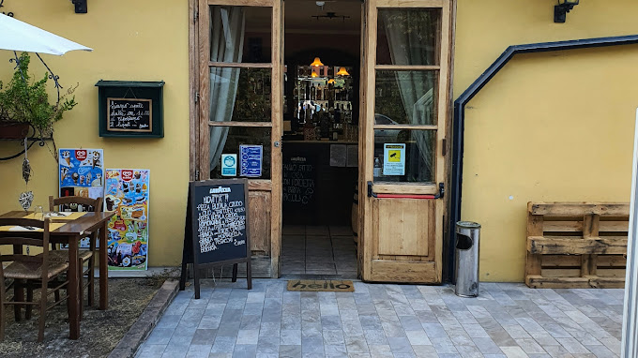
Other recommended Cafes, Bars, Restaurants (always advisable to book)
Bagni di Lucca and nearby
Ristorante de Marina, in Casoli (next village over)
https://maps.app.goo.gl/a19KbYpUX94VaD3AA
+393889944183
Agriturismo Pian di Fiume (halfway to Bagni di Lucca - on the right, cross over a small bridge)
https://www.piandifiume.it/en/food-and-beverage/restaurant/
Pippo’s Pizza, Via Val di Lima, 55022 Bagni di Lucca LU, Italy
https://maps.app.goo.gl/S3QsiW68vVSwJn6E7

Slide 6
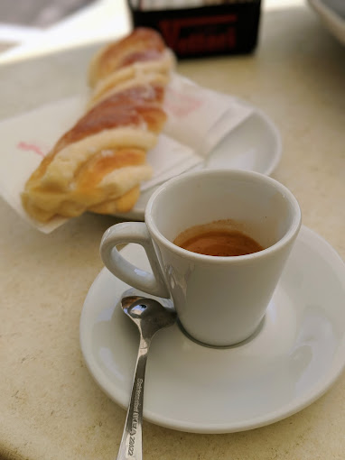
Bagni di Lucca
Bar Roma (in piazza opposite bank in Bagni di Lucca)
Ristorante Circolo
Cafe La Valle
Fuori dal Centro Gelato - just outside Bagni di Lucca
The Joy of Ice cream - Borgo a Mozzano
Lucca
In Pasta (vegetarian)
Piccola Osteria Civico 6
Ciclo Divino
San Colombano
L’isola che c’era
Da Rosolo
Da Ubaldo
Peperosa (michelin star)
Al Corso
Momo Gelato
Ele Gelati
Gelateria la Crema Matta
San Marcello
La Campana Pub
Officina del Gusto (gelateria)
Bracia (meat)
Il Vinaio (cask wine can be purchased after you have tasted it, cheese and other goodies)

Slide 7
Closest towns and villages to visit
Bagni di Lucca (market day in Bagni di Lucca is Wednesday and Saturday morning)
Lucca
San Marcello (visit Suspension Bridge of San Marcello Pistoiese on the way)
Fornolli
Barga Cutigliano
Garfananga
Abetone
Florence
Montecarlo, outside of Lucca, for wine tasting
Local Hilltop Villages to Explore (as small as Vico Pancellorum)
Lucchio (walk to the fort ruins)
Casoli
Limano
Many others too
I hope you have a wonderful stay at the very special Casa Di Mister John.
Best wishes, Sally

Slide 8
